Slide 1
Driving with a congestion assistant; mental workload and acceptance
Karel A. Brookhuis , Cornelie J.G. van Driel , Tineke Hof ,
Bart van Arem , Marika Hoedemaeker
期刊：Applied Ergonomics
指導教授：柳永青
學生：張語軒

Slide 2
Abstract
To gain understanding of the effects of driving with a Congestion Assistant on drivers
A system that combines the features of a Congestion Warning System and a Stop & Go system

Slide 3
Introduction
Operator support systems have been widespread in aviation for a long time already, while active operator support in surface transportation is introduced only quite recently
Systems that have safety as primary objective are expected to gain considerable savings in casualties.
The development and introduction of driver support systems in road traffic, although originally instigated by safety, has been pushed mainly by efficiency and comfort

Slide 4
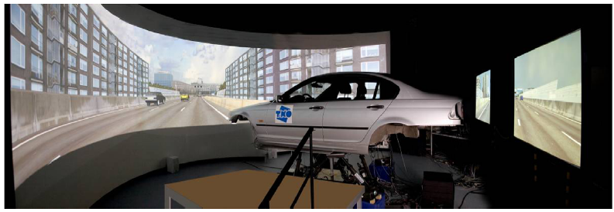
Method
37 volunteers(7 females,30 males)
Age between 23 and 60 years old
Had driving license for 5 years or more
Drove regularly

Slide 5
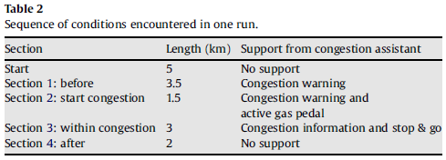
Apparatus and procedure
The participants were invited to TNO for driving in the simulator during four runs of 15 km each
This resulted in four conditions:
1 without Congestion Assistant during normal visibility
2 with Congestion Assistant during normal visibility
3 without Congestion Assistant during fog
4 with Congestion Assistant during fog

Slide 6
Apparatus and procedure
The traffic jam itself had a length of 3 km, implying that the participants left the traffic jam after about 13 km from the start
The Congestion Assistant supported the driver during the whole congested traffic situation. The functions of the Congestion Assistant were programmed to switch on or off at fixed points in each trial.

Slide 7
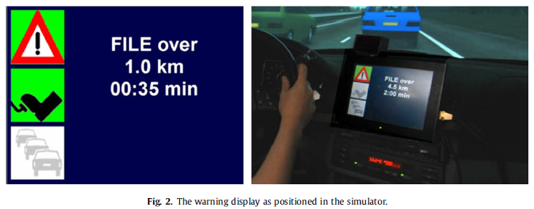
Human-Machine interfacing
The interface consisted of visual, acoustic and haptic feedback.
The display was positioned next to the steering wheel and consisted of three icons and a textbox.
Upper icon: congestion warning and information
Middle icon: active gas pedal
Lower icon: Stop & Go

Slide 8
Mental workload measures
The cardiac function that can be used to measure mental workload
Generally, the higher the average heart rate and the lower the heart rate variability, the more mental effort has to be spent

Slide 9
Secondary Task
The task (and instruction) is merely the detection of stimuli that were presented regularly in the periphery of the functional visual field. The idea behind it is that the functional visual field decreases with increasing workload in the primary task.

Slide 10
Self-report measures
Self-report measures are used to measure the subjectively experienced mental effort. This method is based on the operator’s rating of his performance.
The Rating Scale Mental Effort is an example of a self-report measure. It is a one-dimensional scale, ranging from ‘no effort’ to ‘extreme effort

Slide 11
Acceptance of the Congestion Assistant was registered before the actual driving task started, based on functional description, and after each trial in the Congestion Assistant condition, using the acceptance scaling technique, resulting in a usefulness score and a satisfaction score.

Slide 12
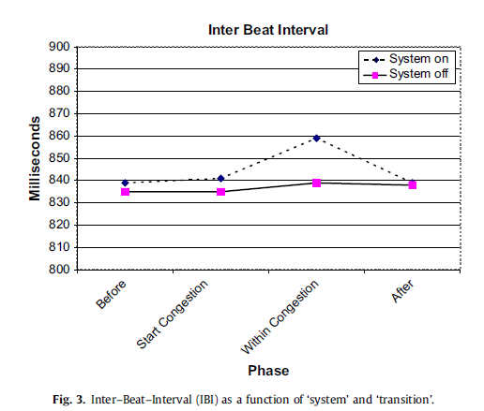
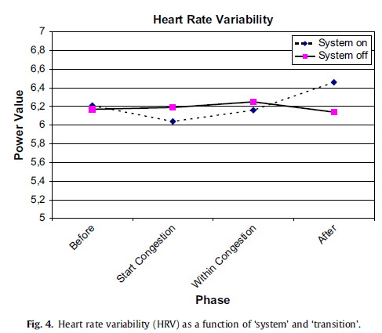
Results -Heart rate and heart rate variability
The results showed a significant main effect in HR of ‘section’ (F(3,81) =13.9, p <0.001) and a significant interaction effect between ‘system’ and ‘section’ (F(3,81) =6.6, p< 0.001).
A significant interaction effect between ‘system’ and ‘section’ was found for HRV (F(3,81) =4.3, p< 0.01).
IBI and HR are reciprocal concepts, therefore a higher IBI score represents a lower HR score, meaning that the mental workload was lower in the traffic jam when one was driving with the Stop & Go function of the Congestion Assistant.

Slide 13
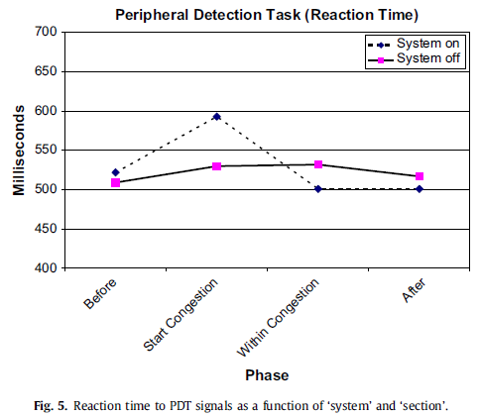
Results -Peripheral detection task
Analyses were performed to investigate the effects of the Congestion Assistant on workload during normal visibility and in fog.
The results with respect to the PDT reaction times showed a significant main effect of ‘section’ (F(3,93) =12.3, p < 0.001) while an interaction effect between ‘system’ and ‘section’ was found as well (F(3,93) =9.6, p< 0.001)

Slide 14
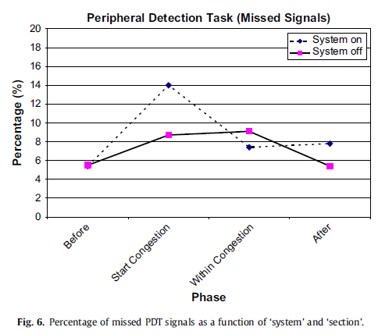
Results -Peripheral detection task
With respect to the percentage of missed PDT signals the results were similar, showing a significant main effect of ‘section’ (F(3,93) =18.6, p < 0.001) and an interaction effect between ‘system’ and ‘section’ (F(3,93) =7.1, p <0.001)
It appeared that when approaching the traffic jam (Section 2), the percentage of missed PDT signals with the Congestion Assistant was larger than without this system.

Slide 15
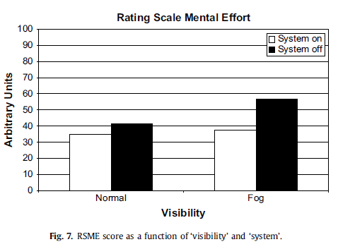
Results -Effort self-report
The results showed significant main effects for both within subject factors ‘visibility’ (F(1,33)=12.4, p <0.01) and ‘system’ (F(1,33)=16.4, p < 0.001).

Slide 16
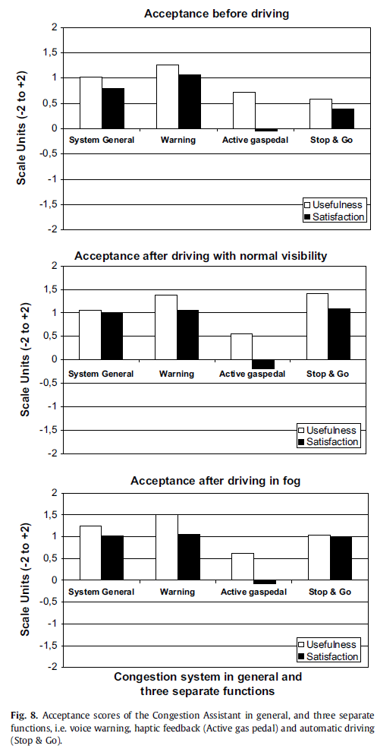
Results -Acceptance of the system
The expectation that the Congestion Assistant would be accepted more in fog than during normal visibility was not clearly supported by the results.

Slide 17
Discussion and Conclusion
The Congestion Assistant did not affect the experienced workload in the sense of indicated effort during normal visibility .
The impacts of the acoustic warning function weren’t found.
The workload increased when driving with the active gas pedal and decreased when driving with the stop & Go
It was found from the RSME data that the participants experienced driving during normal visibility as being less effortful than driving in fog

Slide 18
Discussion and Conclusion
It is clear that the results obtained by the heart rate data do not always correspond to the results from the effort scale and also from the PDT
The PDT may be more sensitive for visual workload
The present combination of workload measures enables to form a differentiating picture of the driver’s mental workload caused by the Congestion Assistant

Slide 19
Discussion and Conclusion
The participants reported that they appreciated the Congestion Assistant. They thought it could increase traffic safety and efficiency, while it would assist them in some of the situations that were incorporated in the experiment.
The results showed that the active gas pedal was least appreciated as feedback mechanism, while the mental workload was higher with the active gas pedal than without this function.

